Slide 1
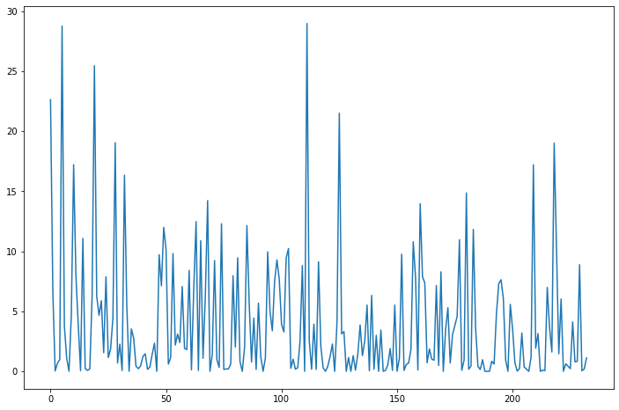
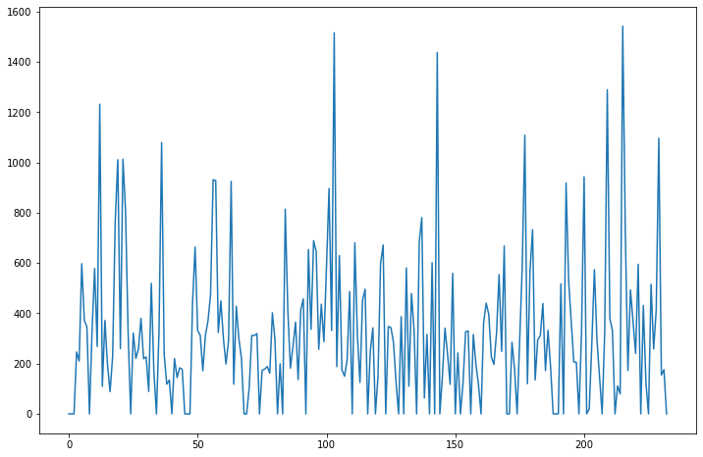
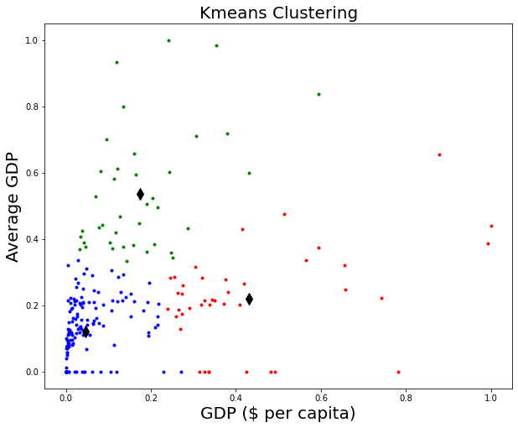
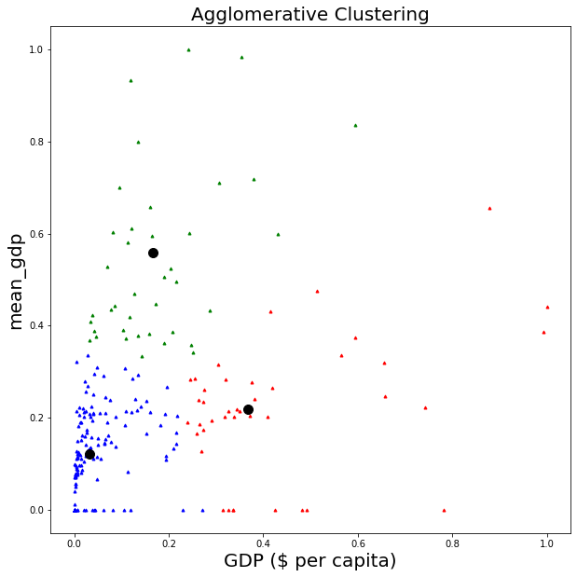
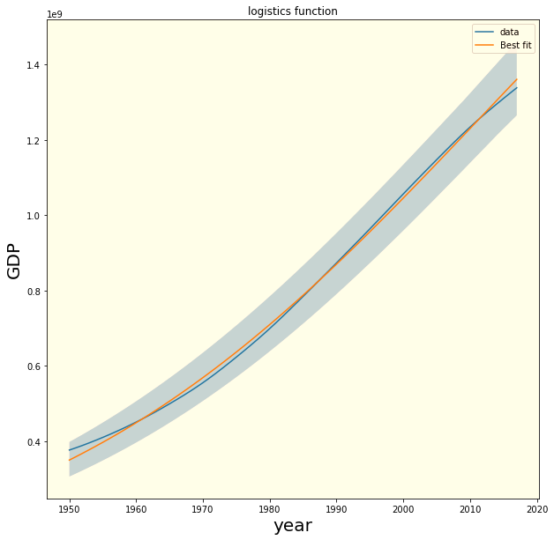
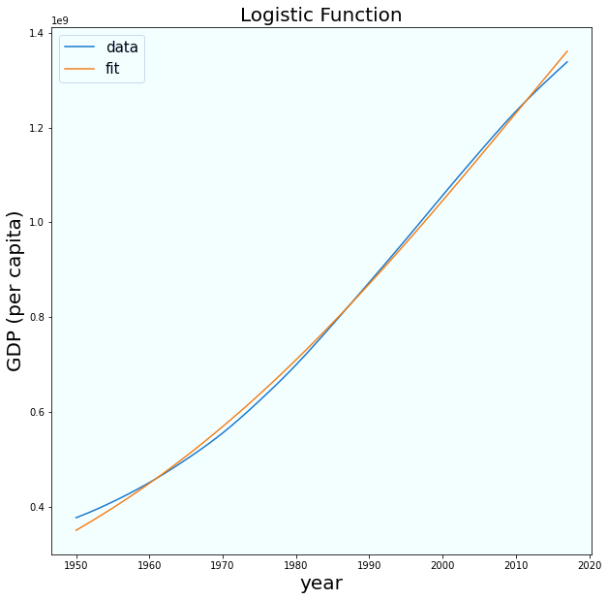
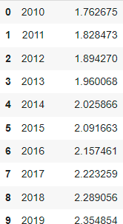
Analyzing Countries Development via 𝐶𝑂₂ Emissions through K-means/Agglomerative Clustering and Logistic Regressions
INTRODUCTION
GDP per capita and CO₂ Emission are the two main scenarios by which world development has been analyzed and compared around the world. The idea behind this research is classifying countries w.r.t. their development made in last 30 years. In last decade, CO2 emission is exponentially rising due to which countries data has been highlighted to figure out the reasons behind anti-progression. We see how much countries GDP lies with same ranges and which are not in same but similar to other countries.
K-means clustering has been used by focusing on 3 clusters in start and then verified out finding with the Agglomerative clustering results and clustering labels.
Fig 1: 𝐶𝑂₂ emission (averaged) values fluctuating w.r.t. years.
Fig 2: $ of GDP per capita fluctuating w.r.t. year but somehow stable.
METHODOLOGY
Data Fitting & 95% Confidence Interval
Fig 5: Best fit for each country with 95% confidential interval
Fig 3: K-means clustering of (Normalized) GDP per capita showing 3 main clusters with outliers.
Fig 4: Agglomerative clustering of (Normalized) GDP per capita showing 3 main clusters with outliers
ANALYSIS
Details: The dataset is chosen from time interval of 1990 and 2010. There has been preprocessed, normalized and transformed data has been used for clustering and fitting of data.
Cluster Number | 𝐶𝑂₂ Emissions (metric tons per capita) | Gross Domestic product (GDP)
1 | 8.64 | 42536
2 | 3.87(64%) | 6524
3 | 5.12 (65%) | 2413
Year | Prediction
CONCLUSION
Very few country statistics are counted in outliers, showing most of the countries are in same clusters.
65% of the countries GDP are in good conditions in past 30 years while the CO2 emission is high as well with the world moving to development.
Carbon footprint, giving bad pollutants to the nations also showing these nations are making money exponentially
Will these "mostly industrialized nations" maintain their high GDP, life expectancy, and urban population as they are forced to reduce emissions? Time will only tell.
References
Figure 6: Predictions for next ten years for each country
https://data.worldbank.org/topic/19
MATEBR, R. J., & Hirst, A. C. (1999). Climate change feedback on the future oceanic CO2 uptake. Tellus B, 51(3), 722-733
Wu, J. (2012). Cluster analysis and K-means clustering: an introduction. In Advances in K-means Clustering (pp. 1-16). Springer, Berlin, Heidelberg.
https://scikit-learn.org/stable/modules/generated/sklearn.cluster.KMeans.html

